Slide 1
Deep Joint Source Channel Coding for Wireless Image Transmission with OFDM
M. Yang, C. Bian and H. -S. Kim, “Deep Joint Source Channel Coding for Wireless Image Transmission with OFDM,” ICC 2021 - IEEE International Conference on Communications, 2021, pp. 1-6 (cited by 10)
Advisor: Dr. Chih-Yu Wang
Presenter: Shao-Heng Chen
Date: May 04, 2022
Notes:
2021年6月發表於 IEEE ICC 會議的論文

Slide 2
Outline
1. Overview
2. Proposed JSCC framework
3. Network structure
4. Evaluations
5. Conclusions and future works
1

Slide 3
Overview
1. Model-driven vs. Data-driven DL framework
– Combine with domain knowledge, mathematical models
2. Use non-trainable but differentiable layers to model multipath channel
– Consider AWGN and Rayleigh flat fading channel
3. OFDM extension design by using NN layers
2

Slide 4
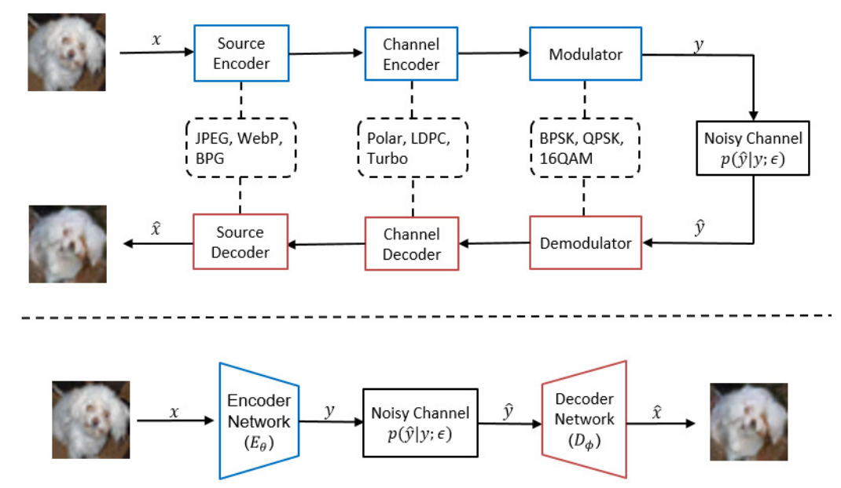
Traditional vs. DL based wireless Tx schemes
– Separate source and channel coding vs. DL based JSCC
3

Slide 5
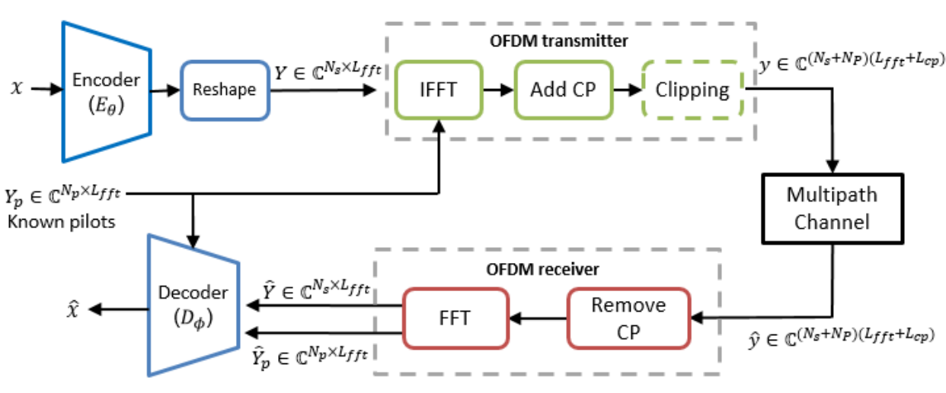
Proposed JSCC Framework
– Proposed JSCC framework with OFDM extension
4
Notes:
Source image x, pilot symbol Np, information symbol Ns, transmit signal y
Frequency domain information symbol Y, frequency domain pilot symbol Yp, OFDM subcarrier number Lfft

Slide 6

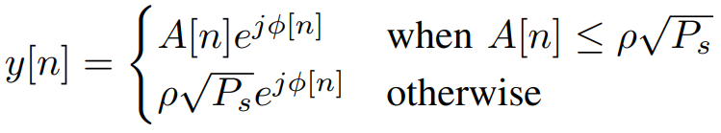
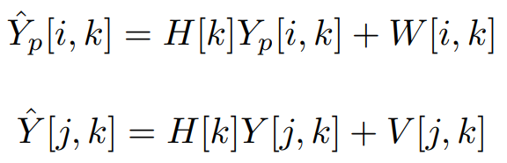


JSCC with OFDM Extension and Signal Clipping
5
Notes:
Noisy channel output y hat, suppose we have signal clipping y[n], after remove Cyclic Prefix (CP) and apply DFT Yp hat, Y hat

Slide 7
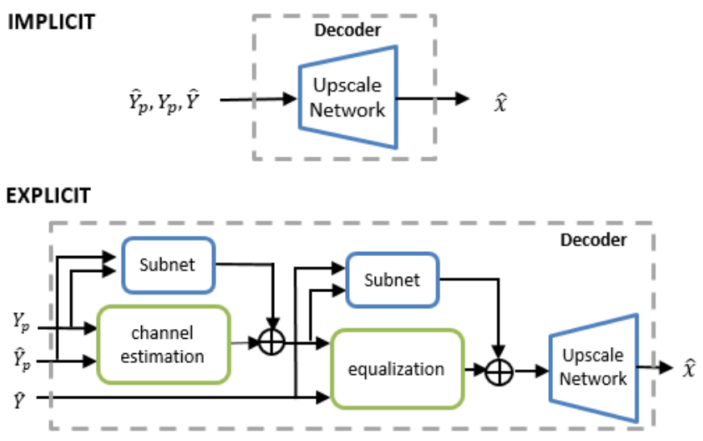
Decoder Design with Domain Knowledge
– Decoder. IMPLICIT (directly concatenate), EXPLICIT (channel est. and equal.)
6

Slide 8
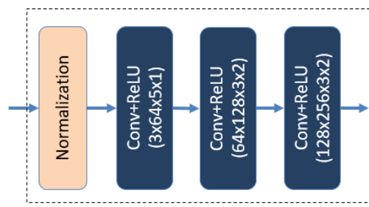
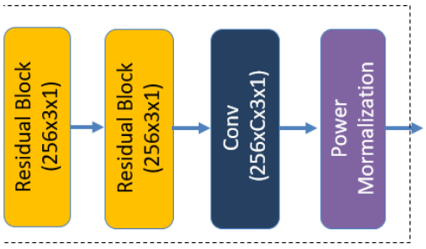
Network Structure
– Encoder structure [1]
[1] Deep-JSCC-for-images-with-OFDM (https://github.com/mingyuyng/Deep-JSCC-for-images-with-OFDM/blob/master/models/channel.py)
7

Slide 9
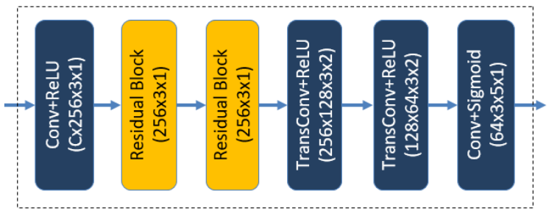
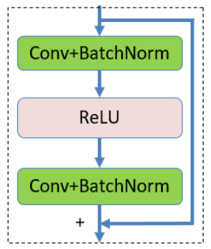
Network Structure
– Residual Block [2]
– Decoder structure
[2] Batch Convolutional Layers (https://github.com/pytorch/pytorch/issues/ 17983)
8

Slide 10
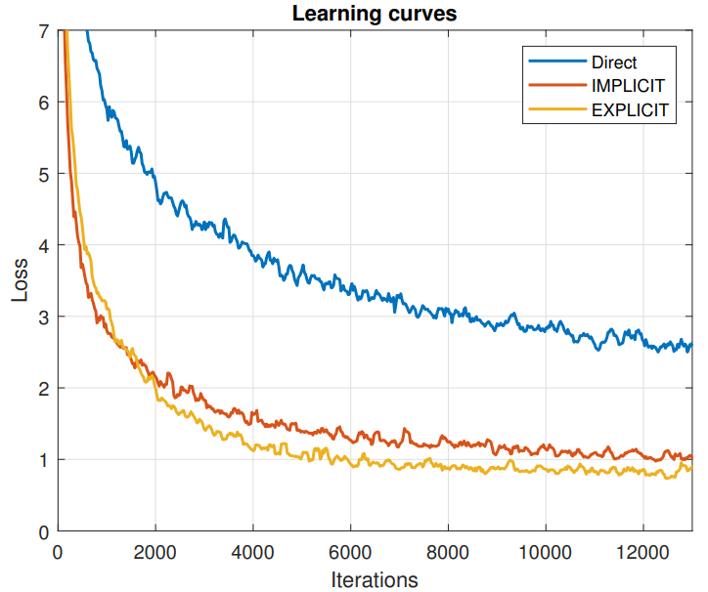
Experimental results
–
9

Slide 11
Conclusions and Future Works
– Useful insights
(1) Could adopt some ideas on DL_CFAR
(2) Baseline comparison
– Problems
(1) The decoder design might be too heavy for edge scenario? around 500kB
(2) CFAR related domain knowledge required
10

Slide 12
Experimental results
– Minimum On-device Comp. with Comm. Overhead less than raw data
10

Slide 13
Experimental results
11

Slide 14
Experimental results
– Accuracy degradation for testing generalization ability
12

Slide 15
Experimental results
– Accuracy degradation for testing generalization ability
13

Slide 16
Conclusions and Future Works
– Useful insights
(1) Model the wireless channel as a non-trainable seems reasonable
(2) Not all layers can be use as a splitting point
– Ideas
(1) Maybe first test on DL_CFAR, before jump into YOLO_CFAR
(2) Is there any information leakage from the encoder output?
– Problems
(1) How to actually model a wireless channel as a non-trainable layer
(2) Need to figure out the reasonable settings for CFAR case
14

